Slide 1
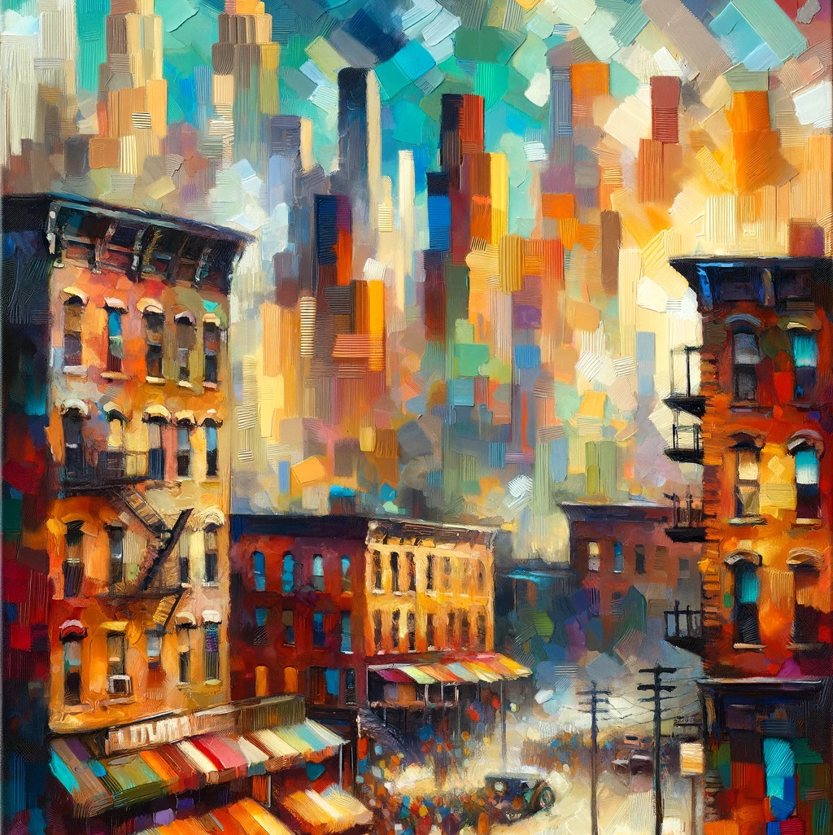
The Walls of Jericho
Rudolph Fisher

Slide 2
The Walls of Jericho
Rudolph Fisher

Slide 3
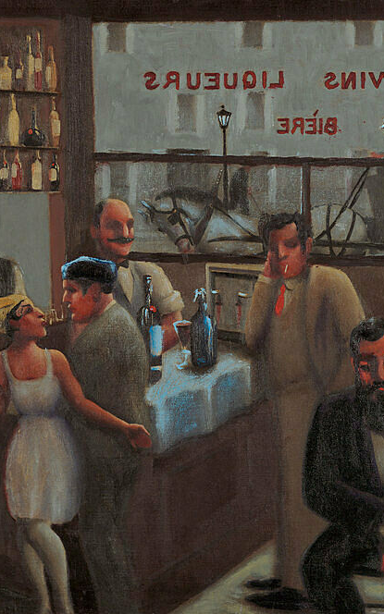
Banjo
Claude McKay

Slide 4
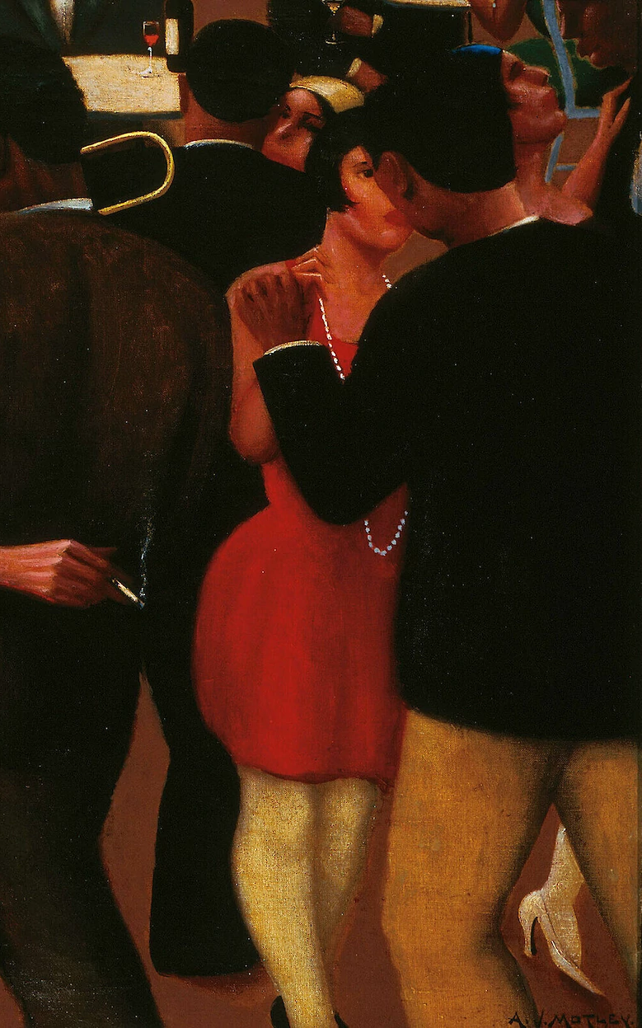
The Walls of Jericho
Rudolph Fisher

Slide 5
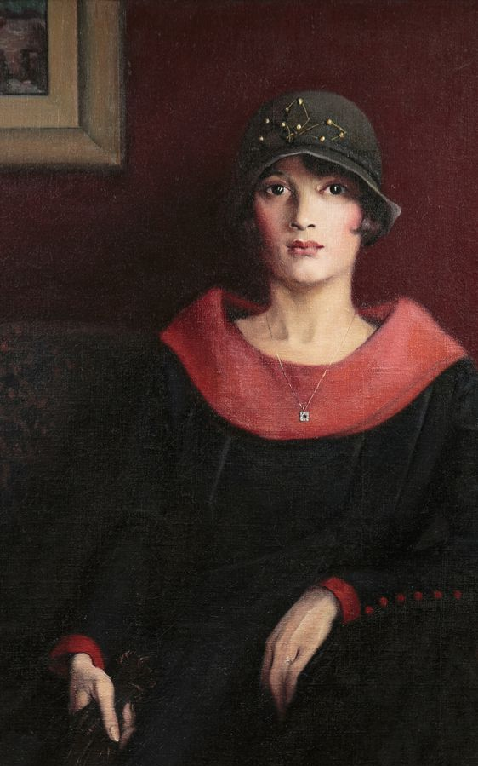
Passing Nella Larsen

Slide 6
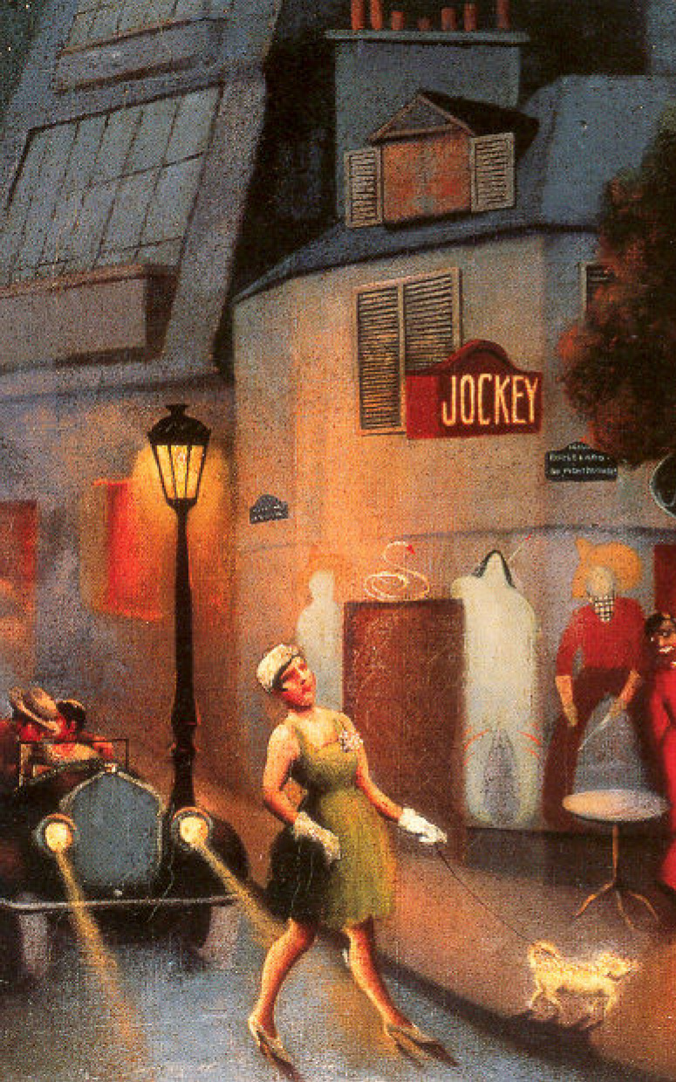
Plum Bun Jessie Redmon Fauset

Slide 7
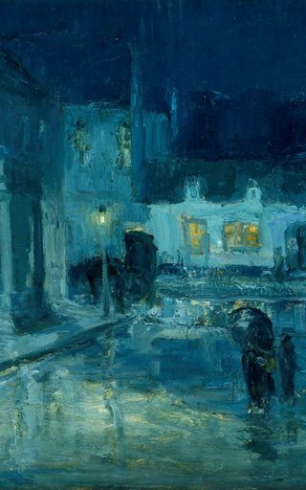
Flight Walter White

Slide 8
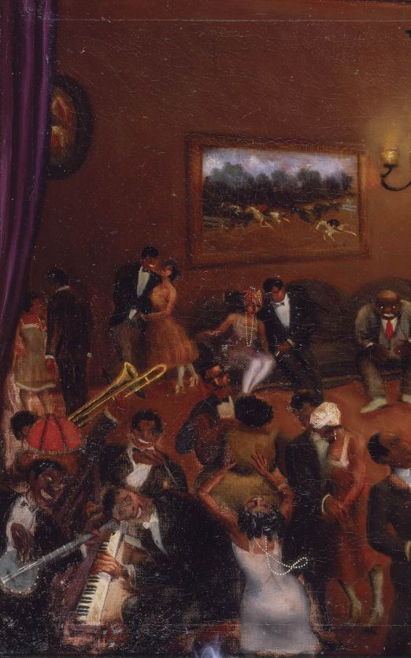
The Blacker the Berry Wallace Thurman

Slide 9
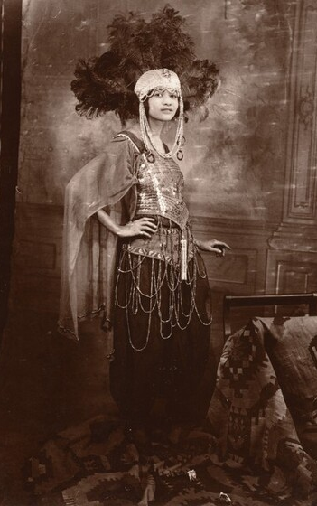
Dark Princess W.E.B Du Bois

Slide 10

Fl ight
Walter White

Slide 11

Dark Princess A Romance
W.E.B. Du Bois

Slide 12

Home to Harlem
Claude McKay

Slide 13
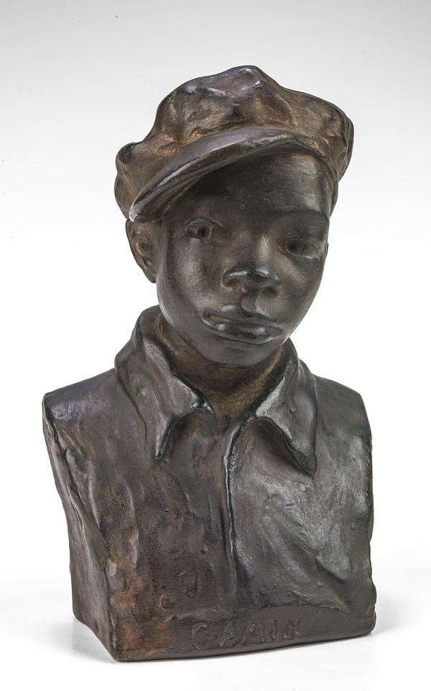
Home to Harlem
Claude McKay

